Slide 1

Software Metrics (SWE2204)
By
John Businge, PhD

Slide 2

Software Metrics
Software Metrics: What and Why ?
How to measure the size of a software?
How much will it cost to develop a software?
How many bugs can we expect?
When can we stop testing?
When can we release the software?

Slide 3
Software Metrics
Software Metrics: What and Why ?
What is the complexity of a module?
What is the module strength and coupling?
What is the reliability at the time of release?
Which test technique is more effective?
Are we testing hard or are we testing smart?
Do we have a strong program or a week test suite?

Slide 4
Software Metrics
Pressman explained as “A measure provides a quantitative indication of the extent, amount, dimension, capacity, or size of some attribute of the product or process”.
Measurement is the act of determining a measure
The metric is a quantitative measure of the degree to which a system, component, or process possesses a given attribute.
Fenton defined measurement as “ it is the process by which numbers or symbols are assigned to attributes of entities in the real world in such a way as to describe them according to clearly defined rules”.

Slide 5
Software Metrics
Definition
Software metrics can be defined as “The continuous application of measurement based techniques to the software development process and its products to supply meaningful and timely management information, together with the use of those techniques to improve that process and its products”.

Slide 6
Software Metrics
Areas of Applications
The most established area of software metrics is cost and size estimation techniques.
The prediction of quality levels for software, often in terms of reliability, is another area where software metrics have an important role to play.
The use of software metrics to provide quantitative checks on software design is also a well established area.

Slide 7
Software Metrics
Developer Statement | Management view
Software development is to complex; it cannot be managed like other parts of the organization. | Forget it, we will find developers and managers who will manage the development.
I am only six months late with the project | Fine, you are only out of the job
But you cannot put reliability constraints in the contract | Then we may not get the contract
Problems During Implementation

Slide 8
Software Metrics
Categories of Metrics
Product metrics: describe the characteristics of the product such as size, complexity, design features, performance, efficiency, reliability, portability, etc.
Process metrics: describe the effectiveness and quality of the processes that produce the software product. Examples are:
effort required in the process
time to produce the product
effectiveness of defect removal during development
number of defects found during testing
maturity of the process

Slide 9
Software Metrics
Project metrics: describe the project characteristics and execution. Examples are :
number of software developers
staffing pattern over the life cycle of the software
cost and schedule
productivity

Slide 10
Software Metrics
Token Count
The size of the vocabulary of a program, which consists of the number of unique tokens used to build a program is defined as:
where
η = η₁+ η₂
η : vocabulary of a program
η₁ : number of unique operators
η₂ : number of unique operands

Slide 11
Software Metrics
The length of the program in the terms of the total number of tokens used is
where
N = N₁+N₂
N : program length
N₁ : total occurrences of operators
N₂ : total occurrences of operands

Slide 12
Software Metrics
Volume
V = N * log₂ η
The unit of measurement of volume is the common unit for size “bits”. It is the actual size of a program if a uniform binary encoding for the vocabulary is used.
Program Level
L = V* / V
The value of L ranges between zero and one, with L=1 representing a program written at the highest possible level (i.e., with minimum size).

Slide 13
Software Metrics
Program Difficulty
D = 1 / L
As the volume of an implementation of a program increases, the program level decreases and the difficulty increases. Thus, programming practices such as redundant usage of operands, or the failure to use higher-level control constructs will tend to increase the volume as well as the difficulty.
Effort
E = V / L = D * V
The unit of measurement of E is the elementary mental discriminations

Slide 14
Software Metrics
Estimated Program Length
∧
Ν = η₁ log ₂ η₁ + η ₂ log ₂ η ₂
∧
Ν = 14 log₂ 14 +10 log₂ 10
= 53.34 + 33.22 = 86.56
The following alternate expressions have been published to estimate program length.
Ν _{J} = Log₂ (η₁!) + log₂ (η₂!)

Slide 15
Software Metrics
Ν _{B} = η₁Log₂η₂ +η₂ log₂ η₁
Ν_{c} = η₁ η₁ +η₂ η₂
Ν _{s} = (η log₂ η) / 2
The definitions of unique operators, unique operands, total operators and total operands are not specifically delineated.

Slide 16
Software Metrics
Counting rules for C language
Comments are not considered.
The identifier and function declarations are not considered.
All the variables and constants are considered operands.
Global variables used in different modules of the same program are counted as multiple occurrences of the same variable.

Slide 17
Local variables with the same name in different functions are counted as unique operands.
Functions calls are considered as operators.
All looping statements e.g., do {…} while ( ), while ( ) {…}, for ( )
{…}, all control statements e.g., if ( ) {…}, if ( ) {…} else {…}, etc. are considered as operators.
In control construct switch ( ) {case:…}, switch as well as all the case statements are considered as operators.

Slide 18
Software Metrics
The reserve words like return, default, continue, break, sizeof, etc., are considered as operators.
All the brackets, commas, and terminators are considered as operators.
GOTO is counted as an operator and the label is counted as an operand.
The unary and binary occurrence of “+” and “-” are dealt separately. Similarly “*” (multiplication operator) are dealt with separately.

Slide 19
Software Metrics
In the array variables such as “array-name [index]” “array- name” and “index” are considered as operands and [ ] is considered as operator.
In the structure variables such as “struct-name, member-name” or “struct-name -> member-name”, struct-name, member-name are taken as operands and ‘.’, ‘->’ are taken as operators. Some names of member elements in different structure variables are counted as unique operands.
All the hash directive are ignored.

Slide 20
Software Metrics
Potential Volume
Estimated Program Level / Difficulty
Halstead offered an alternate formula that estimate the program level.
where
V * = (2 +η* ) log (2 +η* )
2 2 2
∧
L = 2η₂ /(η₁Ν₂ )
∧
D
₌ 1 ₌ η₁Ν₂
∧
L
2η₂

Slide 21
Software Metrics
Potential Volume
Estimated Program Level / Difficulty
Halstead offered an alternate formula that estimate the program level.
where
V * = (2 +η* ) log (2 +η* )
2 2 2
∧
L = 2η₂ /(η₁Ν₂ )
∧
D
₌ 1 ₌ η₁Ν₂
∧
L
2η₂

Slide 22
Software Metrics
Effort and Time
β is normally set to 18 since this seemed to give best results in Halstead’s earliest experiments, which compared the predicted times with observed programming times, including the time for design, coding, and testing.
∧ ∧
Ε = V / L = V * D
= (n₁ N₂ N log₂ η) / 2η₂
T = E / β

Slide 23
Software Metrics
Language Level
Using this formula, Halstead and other researchers determined the language level for various languages as shown in Table 1.
λ = L ×V * = L²V

Slide 24
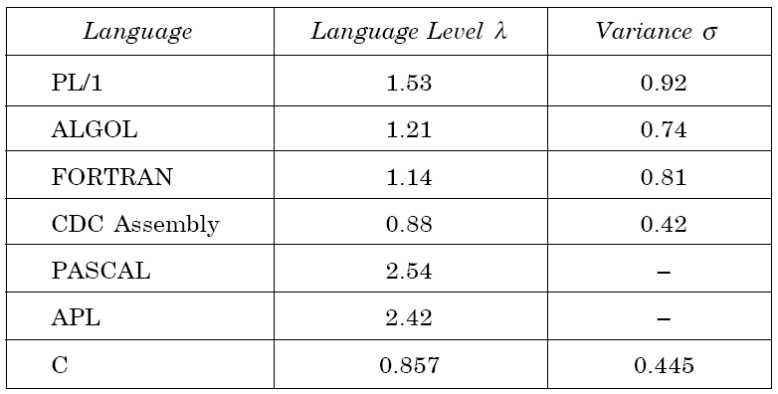
Software Metrics
Table 1: Language levels

Slide 25
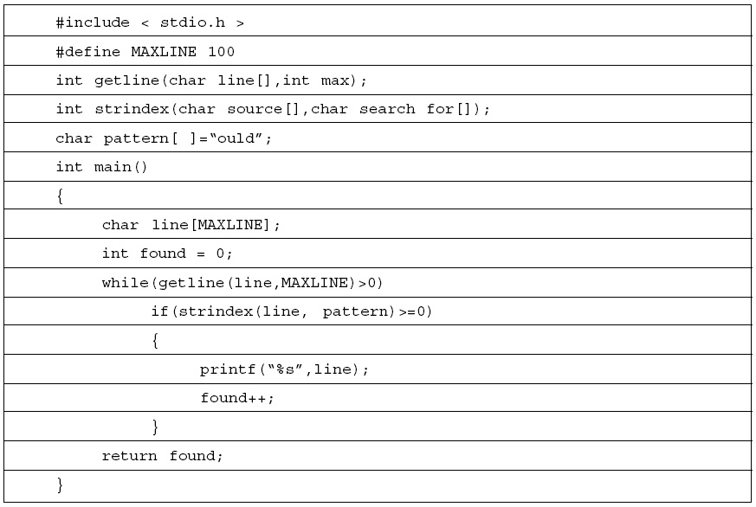
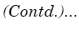
Assignment 1: Due July 13, 2021
Table 1

Slide 26
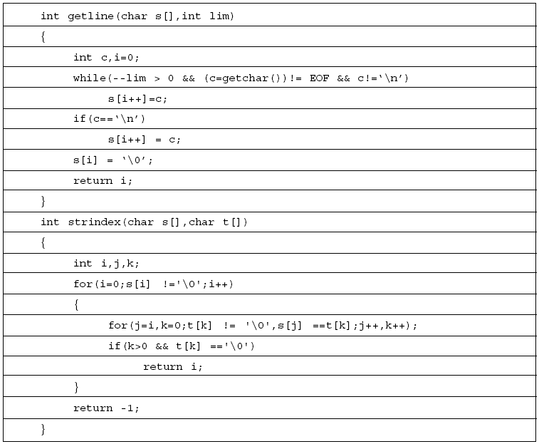
Assignment 1: Due July 13, 2021
Table 1

Slide 27
Assignment 1: Due July 13, 2021
Consider the program in Table 1. Calculate the various software science metrics.
You will submit a softcopy of the work.

